Slide 1
Superconductivity of Materials
Bryce Daniels

Slide 2
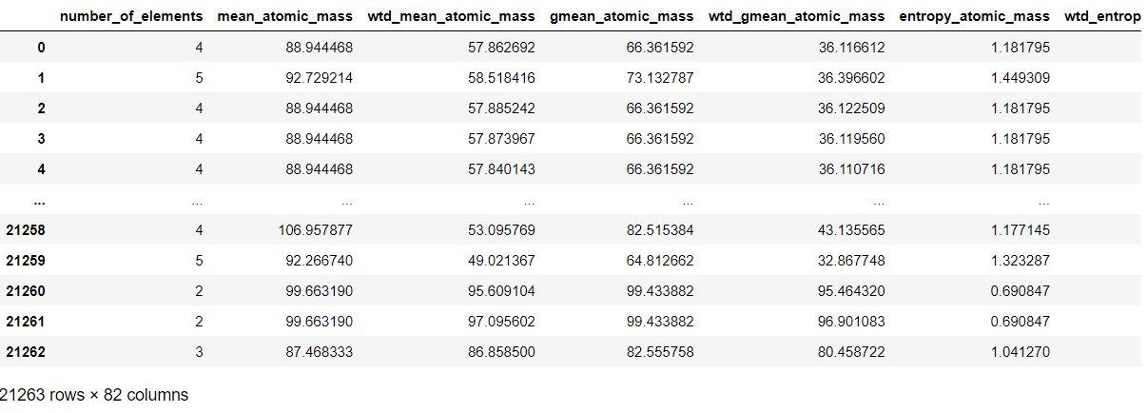
Dataset

Slide 3
Part one
# of Elements v Critical Temperature

Slide 4
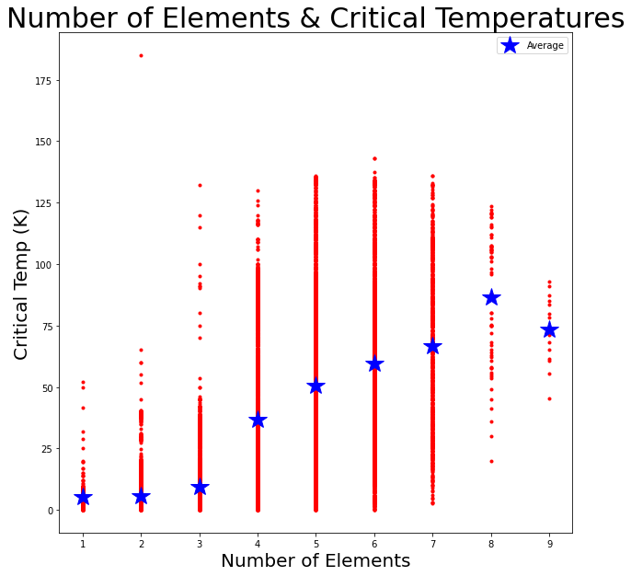
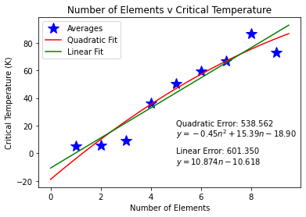

Slide 5
Part two
Maximal Information Coefficient (MIC)

Slide 6


Equations

Slide 7
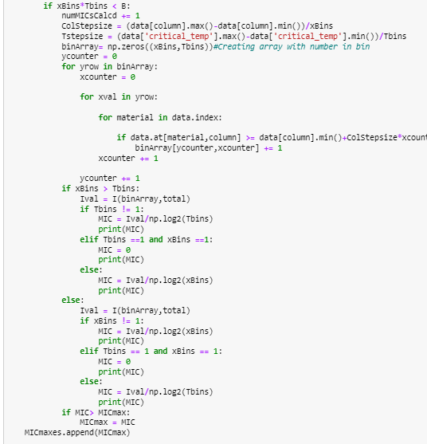
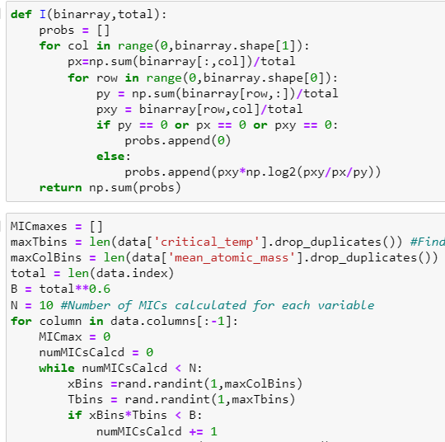
CODE
Calculating I
Generating Array to Calculate I Value from
Calculating MIC
Randomizing # of Bins
Tracking Max MIC

Slide 8
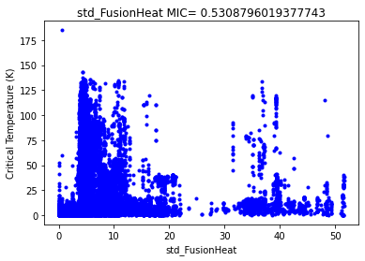
Highest MIC Value = 0.5309
Standard Deviation of Fusion Heat

Slide 9
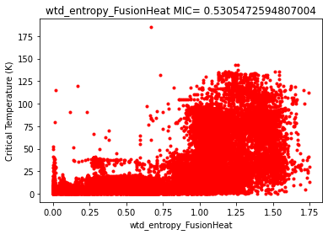
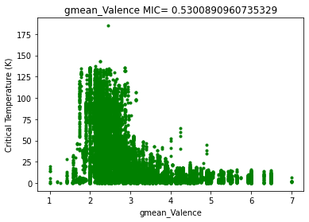
Close Behind
Weighted Entropy of The Fusion Heat
Geometric Mean of # of Valence Electrons

Slide 10
Resources
Kevin Murphy http://noiselab.ucsd.edu/ECE228/Murphy_Machine_Learning.pdf

Slide 11
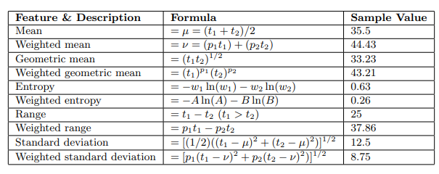
If questions on statistics

